Slide 1

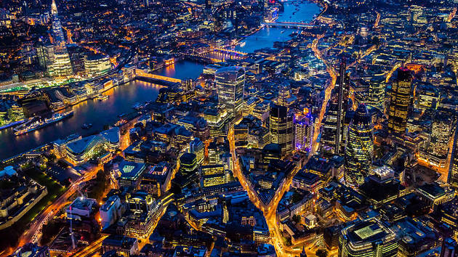
The Battle of the Neighbourhoods
A study of data pertaining to London venues
Shusanah Pillinger | Applied Data Science Capstone | 11 November 2019

Slide 2
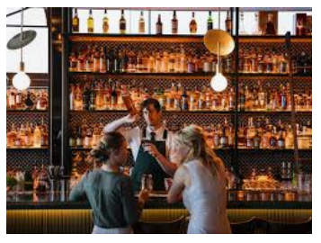
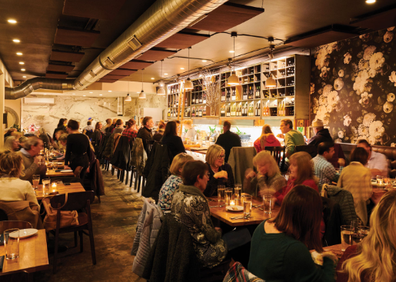
Which Tube station should friends meet at for an evening in London?
Problem Definition
For highly rated bars?
Followed by varied restaurant choice?

Slide 3
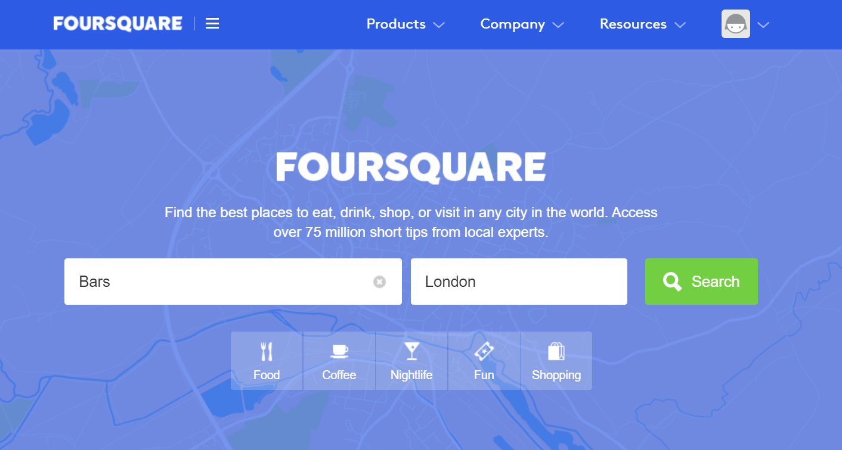
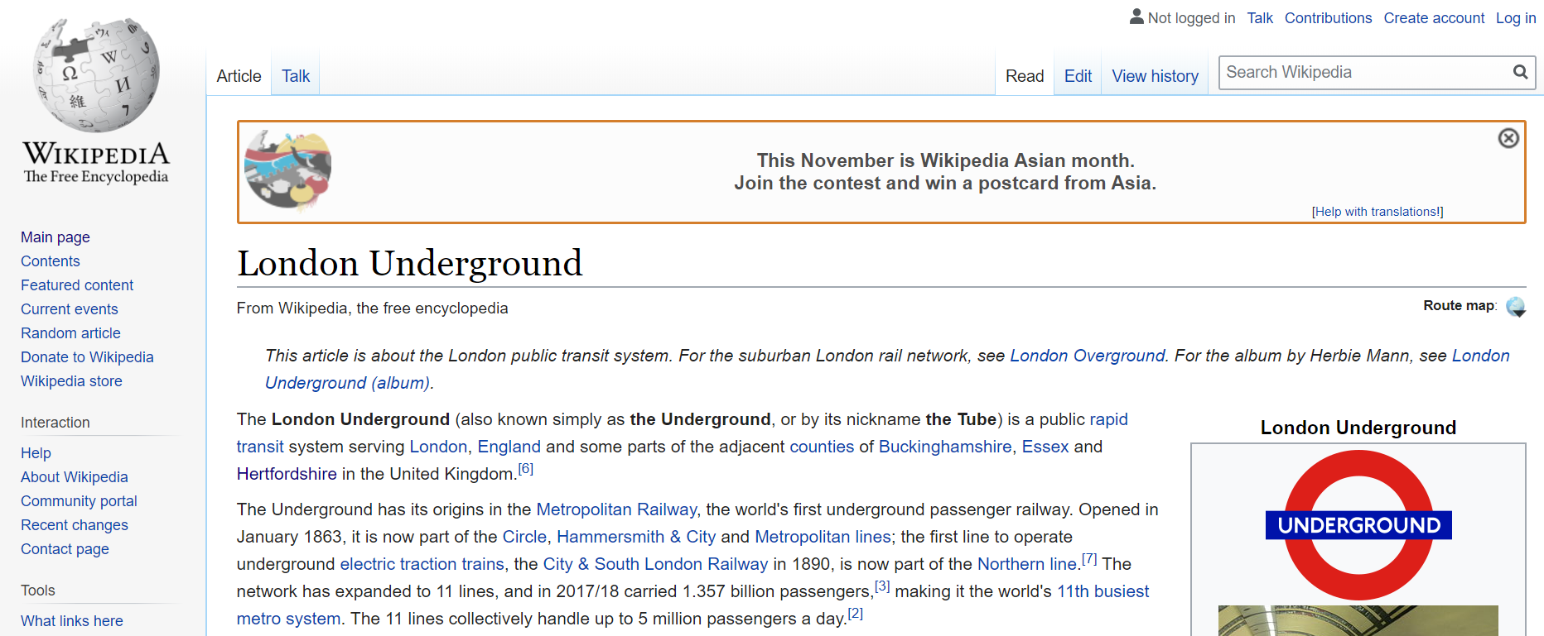
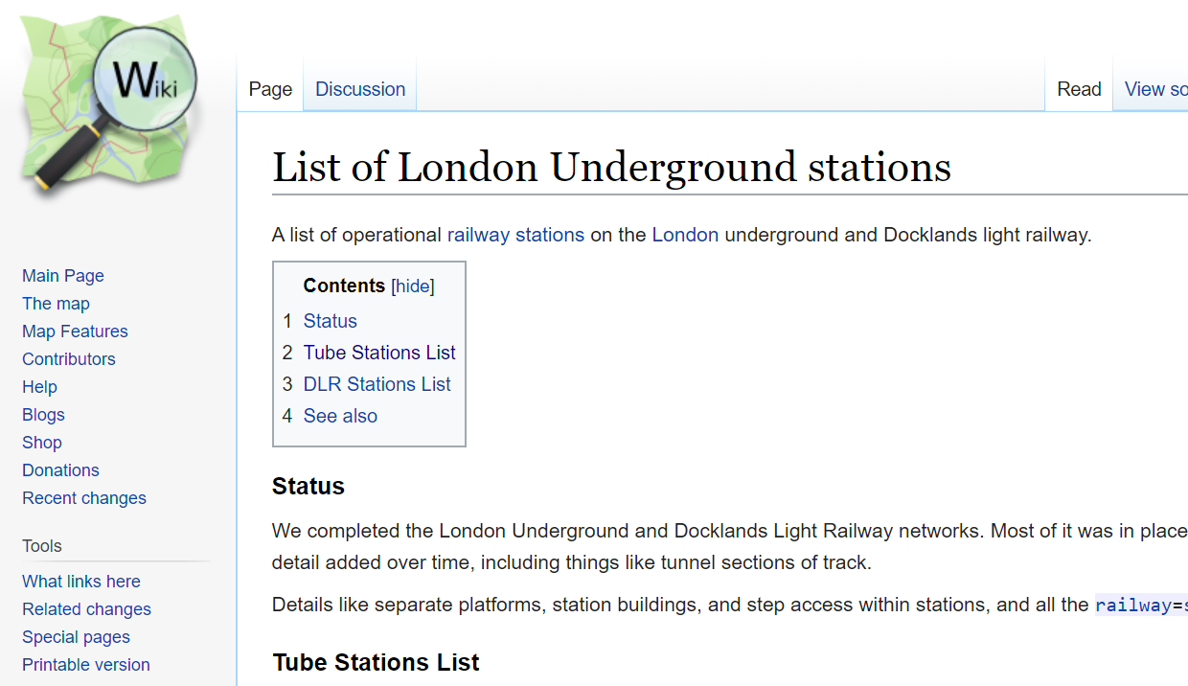

Data
Sources

Slide 4
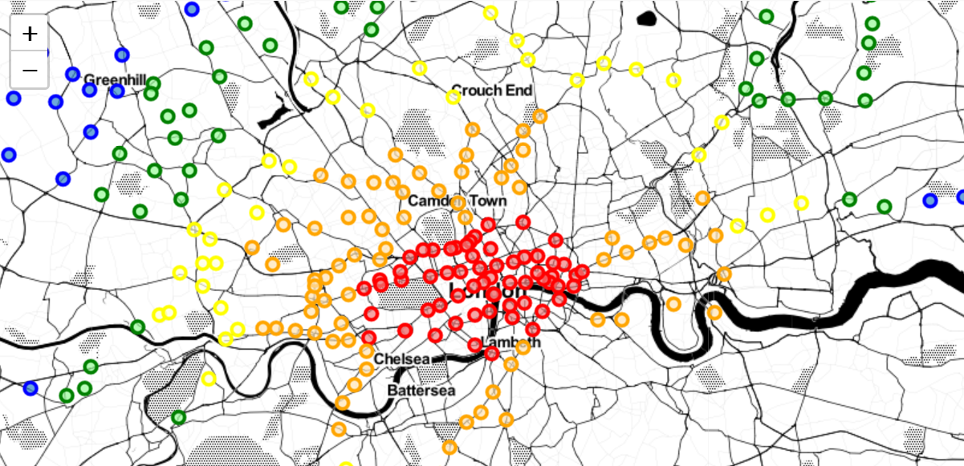
1
2
3
4
5
Tube Stations across London Network Zones

Slide 5
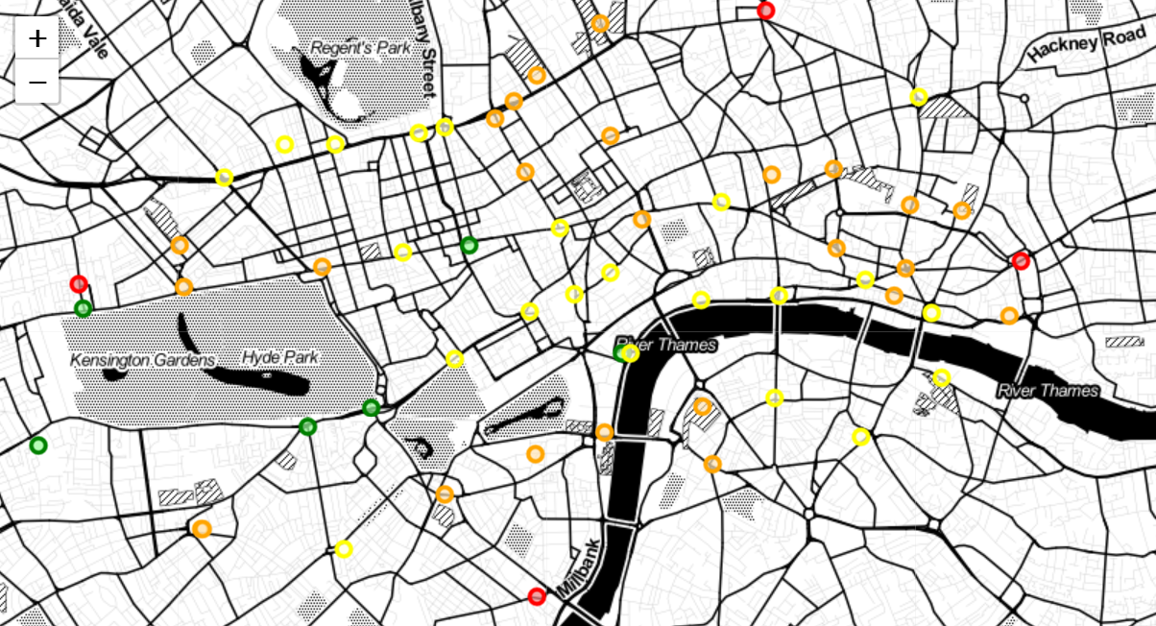
8-9
7-8
6-7
<6
Average Bar Rating near Tube Stations in Zone 1

Slide 6
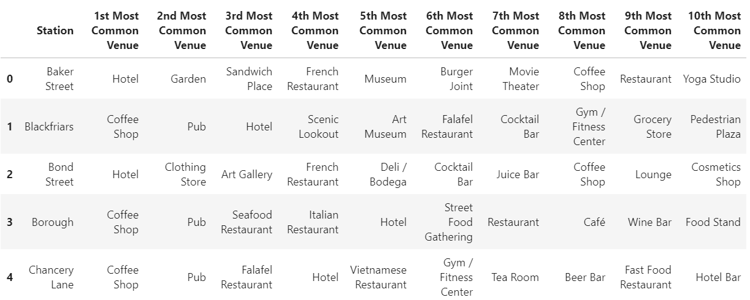
Most Common Venue Categories Nearby Highly Rated Bar Tube Station Areas

Slide 7
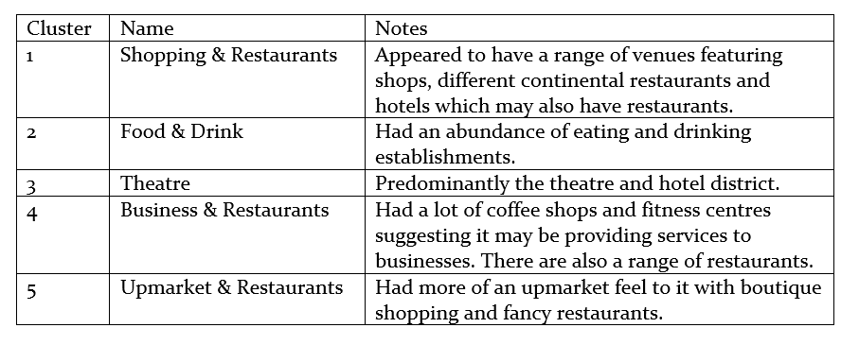
K-means Clustering

Slide 8
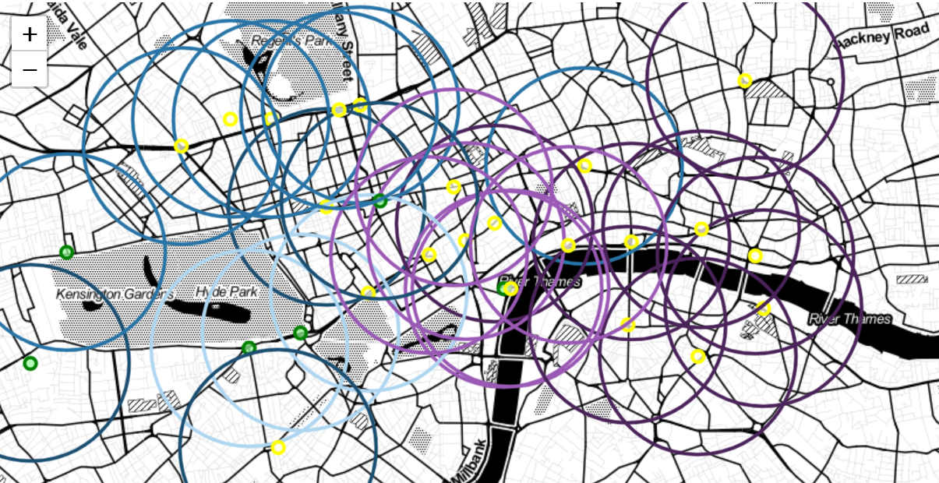
Dark Blue - Shopping & Restaurants
Medium Blue - Food & Drink
Light Blue - Upmarket & Restaurants
Light Purple - Theatre
Dark Purple - Business & Restaurants
Highly Rated Bars with Clusters of Nearby Venues

Slide 9
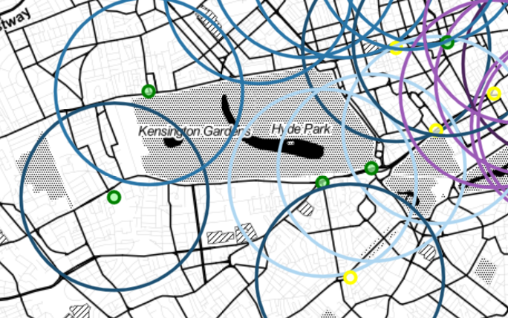
Which Tube station should friends meet at for an evening in London?
Conclusions
For highly rated bars?
Knightsbridge - 8.7
Queensway - 8.5
Hyde Park Corner - 8.2
Charing Cross - 8.1
Oxford Circus - 8.1
High Street Kensington - 8.1
Followed by varied restaurant choice?
Oxford Circus

